Slide 1
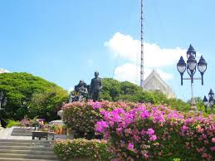
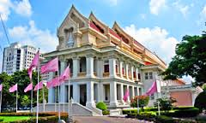
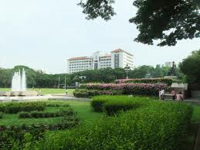
Chulalongkorn University
Thailand’s oldest and one of the country’s most prestigious universities.
Officially established on March 26, 1917 by King Vajiravudh (Rama VI) and named after his father King Chulalongkorn (Rama V).

Slide 2
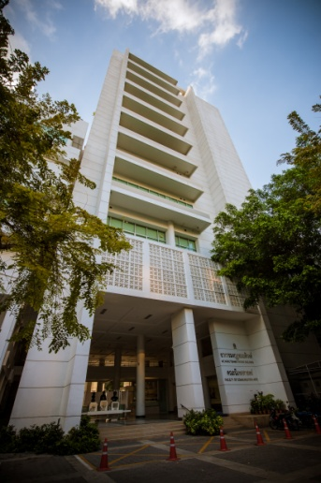
Faculty of Communication Arts
Founded in 1965
Founder: Professor Bumrungsuk Sriha-ampai

Slide 3
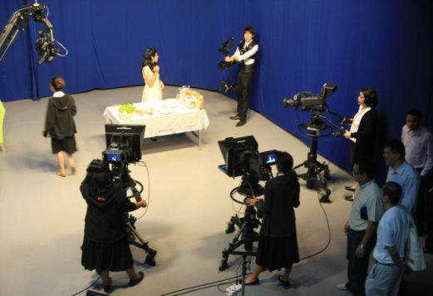
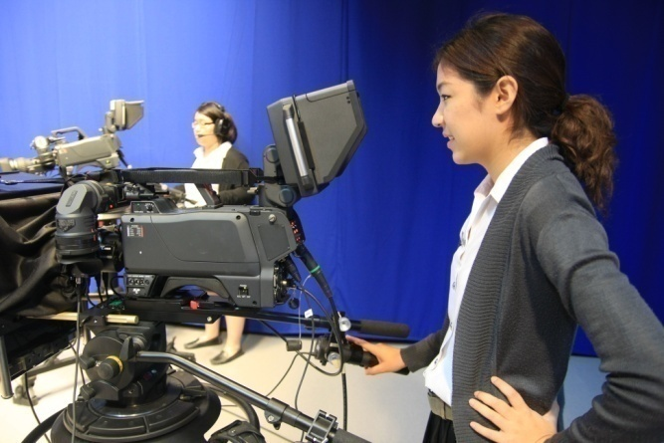
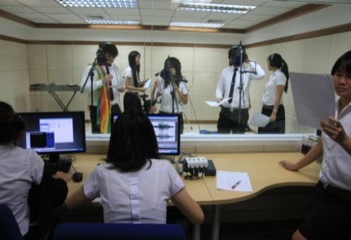
Faculty’s Facilities
Mongkutsamatiwong Building
International Programs Office and International Programs Study Lounge: 6th Floor
Library: 5th floor
Computer Center: 3rd floor
Building 1
Center of Excellence in Digital Media: 2nd -3rd floors
International Programs Office and International Programs Study Lounge: 6th Floor

Slide 4
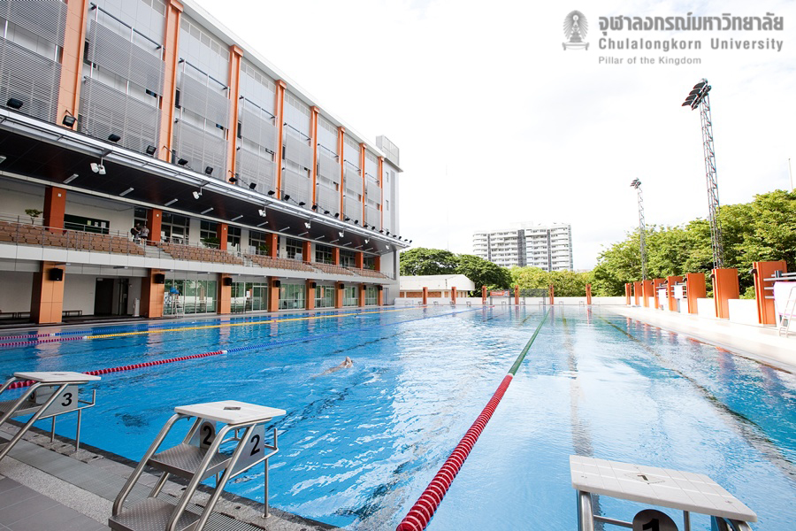
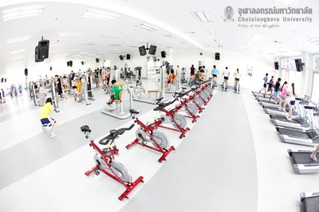
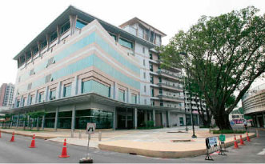
University’s Facilities

Slide 5
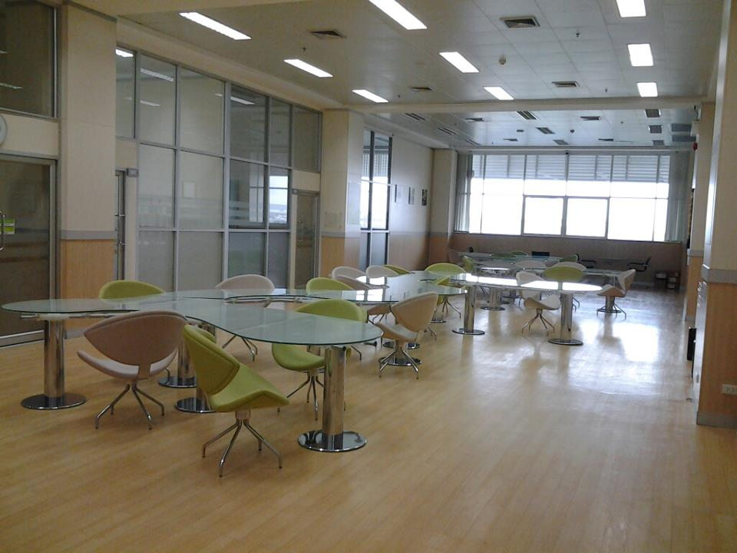
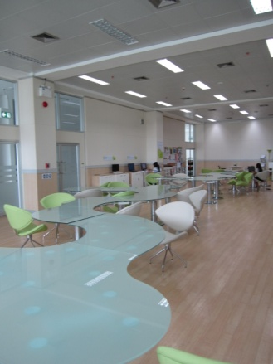
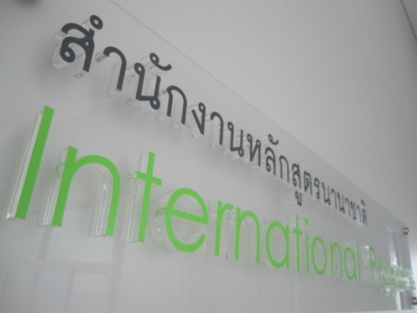
Study Lounge
Located at 6th floor of Mongkutsamatiwong Building

Slide 6
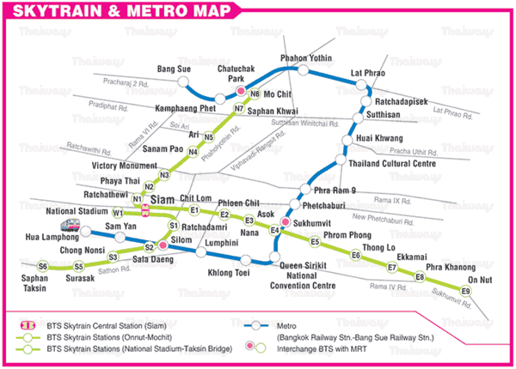
University’s Location
BTS:
Siam Station
National Stadium Station
MRT:
Samyan Station

Slide 7
Where is Faculty of Communication Arts?

Slide 8
Chula Shuttle Bus
Free Chula shuttle bus No. 4 (From BTS Siam)
Stop at Faculty of Law’s Gate (closest to Comm Arts)

Slide 9
Chulalongkorn University
Thailand’s oldest and one of the country’s most prestigious universities.
Officially established on March 26, 1917 by King Vajiravudh (Rama VI) and named after his father King Chulalongkorn (Rama V).

Slide 10
Faculty of Communication Arts
Founded in 1965
Founder: Professor Bumrungsuk Sriha-ampai

Slide 11
Faculty’s Facilities
Mongkutsamatiwong Building
International Programs Office and International Programs Study Lounge: 6th Floor
Library: 5th floor
Computer Center: 3rd floor
Building 1
Center of Excellence in Digital Media: 2nd -3rd floors
International Programs Office and International Programs Study Lounge: 6th Floor

Slide 12
University’s Facilities

Slide 13
Study Lounge
Located at 6th floor of Mongkutsamatiwong Building

Slide 14
University’s Location
BTS:
Siam Station
National Stadium Station
MRT:
Samyan Station

Slide 15
Where is Faculty of Communication Arts?

Slide 16
Chula Shuttle Bus
Free Chula shuttle bus No. 4 (From BTS Siam)
Stop at Faculty of Law’s Gate (closest to Comm Arts)

