Slide 1
Classroom Policy
Faculty of Communication Arts
Chulalongkorn University

Slide 2
University Uniform
Female students:
Must wear white shirt with short sleeves
The university pin must be clasped on the right hand side of the shirt at chest level
The buttons must be in silver with the university emblem
Both navy blue and black skirts are allowed but they must be long enough to cover the knees
The university belt for female students is brown suede belt with the university emblem on the buckle
Slippers are strictly prohibited

Slide 3
University Uniform
Male students:
Must wear white shirt (Either long or short sleeves)
Navy blue or black trousers should accompanied by a leather belt with the university emblem on the buckle
The university tie is usually required when attending any university ceremony
Slippers are also not permitted for male students

Slide 4
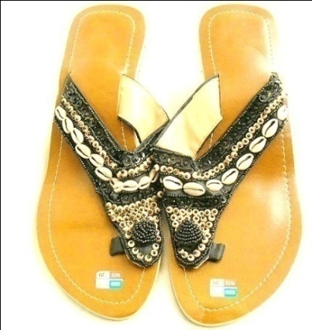
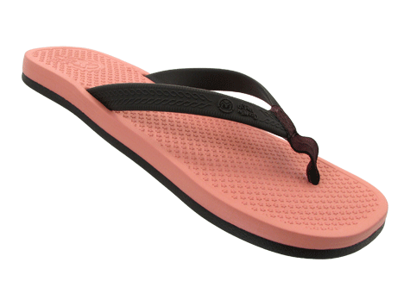
Improper Dress
No short pants
No short skirts
No sleeveless & strapless shirts
No slippers

Slide 5
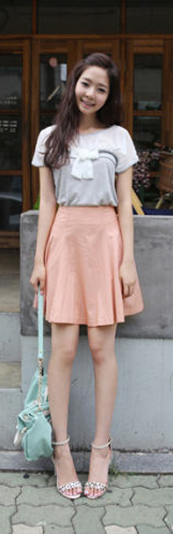
Proper Dress

Slide 6
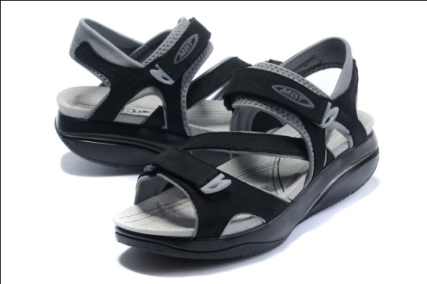
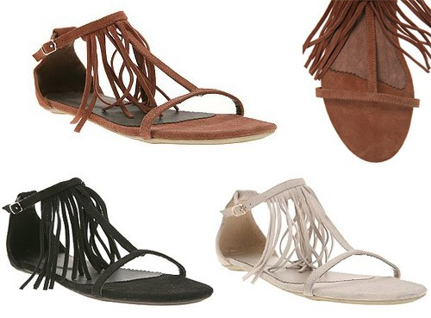
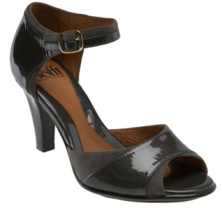
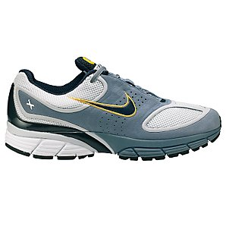
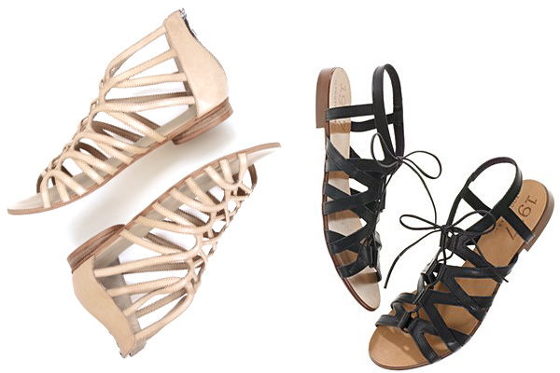
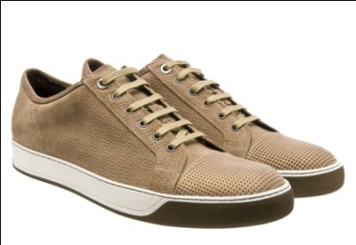
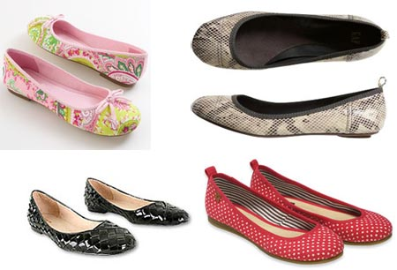
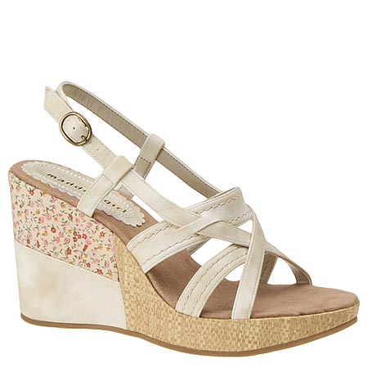
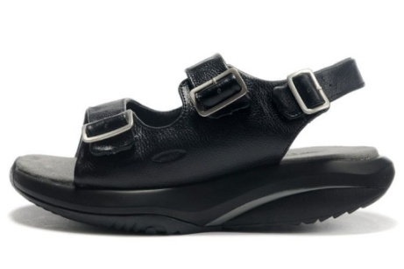
Proper Shoes

Slide 7
Classroom Etiquette
No smoking in the university
No alcohol in the university
Intoxicated person is not allowed in class
No causing disturbances
Respect others: classmates, teachers, other students, staff, etc.
Behave according to Thai laws and respect Thai culture & norms

Slide 8
Classroom Policy
BE ON TIME!
Students are required to attend EVERY CLASS and stay until the lecturer dismisses the class
Attendance is checked.
3 Absences = ban from final exam = F
No food nor drink allowed in classroom

Slide 9
Examination Regulations
Cheating in examination will result in getting an “F” in that subject, and suspended for one academic year.

Slide 10
Who to talk to when you have problems?
Asst. Prof. Shawhong SER
Phone: +66875623120
Email: shaw.h@chula.ac.th / Shawhongser@hotmail.com
International Programs, Faculty of Communication Arts
Tel: +662 218 2215
Email: commarts.mhmk@gmail.com
Facebook:
http://www.facebook.com/communicationmanagement

