Slide 1
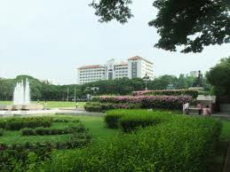
Chulalongkorn University
Thailand’s oldest and one of the country’s most prestigious universities.
Officially established on March 26, 1917 by King Vajiravudh (Rama VI) and named after his father King Chulalongkorn (Rama V).

Slide 2
IMMIGRATION

Slide 3
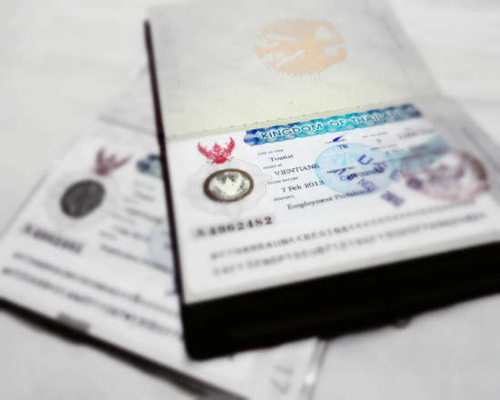
Immigration
VISA (Education Visa)
Extension
Re-Entry Permit

Slide 4
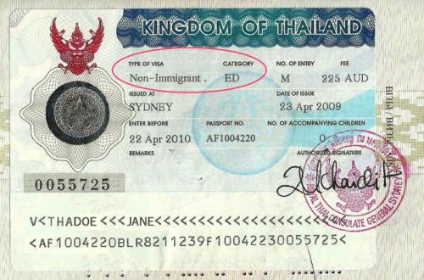
VISA
Student VISA = Non-Immigrant (ED)
Single entry and multiple entry = 90 days to stay in Thailand

Slide 5
Single or Multiple
Single entry VISA is cheaper to extend since you can do it at the immigration office in Bangkok.
You VISA will last until the end of December or according to Immigration officer’s decision.
If you plan to go out of Thailand you can seek a re-entry permit each time you leave the country to keep you student VISA validity OR you can seek a multiple re-entry which allow you to travel in-out of Thailand as much as you like within the period of you VISA validity.

Slide 6
Single or Multiple
Multiple entry may allow you to travel in-out of Thailand after your study ended as long as your VISA allows you.
Remember that you are required to extend this VISA by leaving and re-enter Thailand before your stamp expire (roughly every 85 days)
Generally, you will be granted another 90 days.
Remember:
Always check your destination’s VISA policy.
Most countries in South East Asia region still require VISA to entry.
Regulations may vary country to country.

Slide 7
Warning
Many people mistook 1 Year Multiple-Entry VISA and VISA that valid for 1 year for a VISA that allow them to stay in Thailand for 365 without leaving Thailand
1 Year Multiple-Entry VISA doesn’t mean you can stay in Thailand for a continuing period of 365 days
You are still required to leave Thailand within every 90 days
For example: every 85 days before your stamp running out but you can travel in-out of Thailand within the period of 1 year

Slide 8
When your Visa will expire?
Non-Immigrant Visa allows holder to stay in Thailand for 90 days. When you check your visa’s expiration, it’s NOT theExpiry Date printed on your VISA (which is the last day you can use that VISA to enter Thailand)
The expiration date is 90 days from your entry date and will be stamped in your passport at arrival
IMMIGRATION
SUVARNABHUMI AIRPORT THAILAND
VISA CLASS……ED…….……
Admitted……1 AUGUST 2012…
Until…………29 OCT 2012………
Signed……………………………..

Slide 9
Extension
Visa Extension for Non-Immigrant Visa (ED):
1 month prior to the expiration of your period of stay, contact the International Programs office for the Visa extension letter.
In Bangkok, you will extend your visa at the Immigration Bureau on Chaengwattana Rd.
Visa Extension Fee : approximately 1,900 baht
Documents to be submitted
1. Application form
2. Copy of applicant’s passport
3. Letter of confirmation and request for extension from the Faculty of Communication Arts

Slide 10
REMEMBER
According to Thailand’s immigration regulations, we are able to sponsor you VISA until the end of your period of study which will be December
If you plan to travel longer than 1-2 months you may apply for tourist visa

Slide 11
Re-Entry Permit
Any time you leave Thailand, you need a multiple-entrée visa or re-entry permit
Can be obtained at:
The Government Complex branch, Chaengwattana Road
Office hour: Mon-Fri 8:30 - 16:30

Slide 12
Re-Entry Permit
Documents to be submitted
A completed TM-8 form
A 2" photo
Photocopy of passport (main page, visa page and latest entry stamp)
Fee:
1,000 Baht for single re-entry
3,800 Baht for multiple re-entry

Slide 13
What if I forget to get the re-entry permit?
1) Your student visa will be cancelled when you leave Thailand
2) For holder of German, Austrian, Hellenic, Italian passport:
If you return via land borders (such as between Thailand and Cambodia or Thailand and Laos): 15-day transit visa.
If you return via plane: 30-day transit visa
You cannot apply for new visa in Thailand. You must leave Thailand and obtain one from the Thai Foreign Affairs Mission

Slide 14
What if I forget to get the re-entry permit?
Some nationalities are not allowed to enter Thailand without a VISA.
For example: Bosnian and Croatian
You will need to apply for a new visa at the Thai foreign mission outside the country!
So - DON’T LEAVE THAILAND
WITHOUT A RE-ENTRY PERMIT

