Slide 2
LIVING IN THAILAND

Slide 3
Before leaving for Thailand
If you have special dietary (vegetarian, religious restriction, allergy, or medical restriction) you must notify the airline at least 72 hours
Have a map to your accommodation and map to Faculty of Communication Arts
Don’t pack your house!

Slide 4
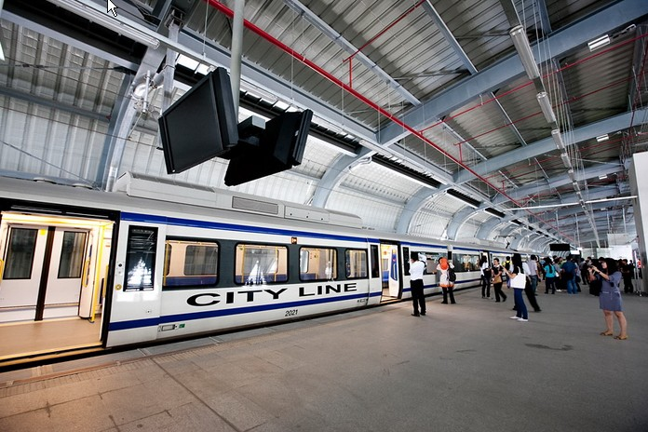
Airport Rail Link
(Every Day: First train at 6.00, Last train at 00.00)
SA City Line (45 baht) & SA Express (90 baht)
Makkasan Station: Close to MRT (subway) Petchaburi Station
Phyathai Station: Interchange to BTS Phayathai Station (3 stations from Chulalongkorn University)
Service at Basement B(Underground)

Slide 5
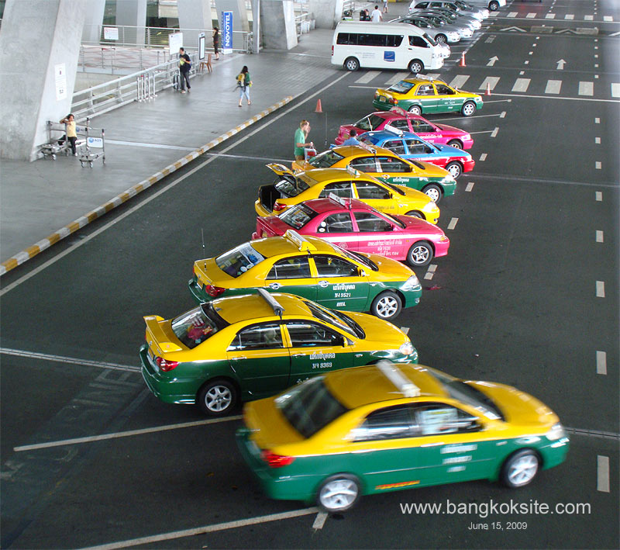
Other Choices
Meter Taxi (24 hr)
Starting at 35 baht + 50 baht airport charge
Platform of Passenger Terminal on the 1st Floor, Gates 4 and 7
Airport Limousine (24hr)
Airport Bus
contact their stands

Slide 6
Warning
If you plan to hire a taxi, you must contact at the taxi stand at Gate 4 and 7 on 1st Floor
Taxi plate number will be registered and you will only ride a taxi that open their meters
Avoid drivers who offer a ‘special price’, they may also trick you that the airport rail link is out of service for hours

Slide 7
Travel within Bangkok
BTS Sky Train – an elevated train
MRT – an underground train
Ticket sold separated
If you are less than 23 years old (not fully 23) you are eligible for student pass (again, sold separately for BTS and MRT with different policy)

Slide 8
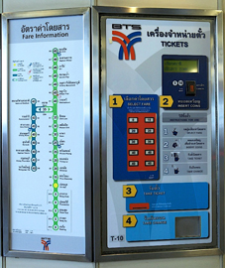
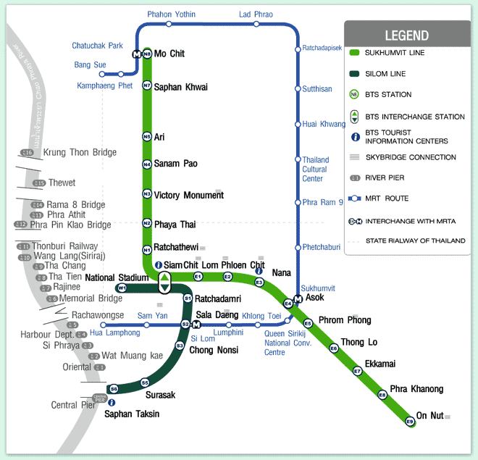
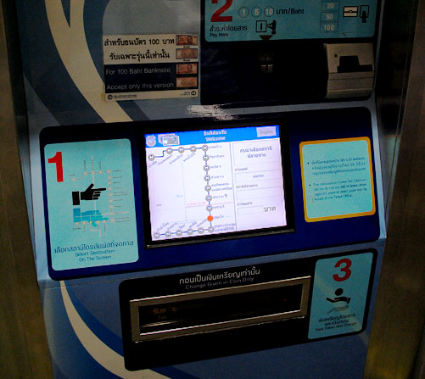
Travel within Bangkok

Slide 9
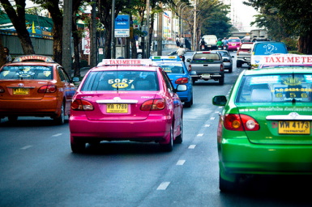
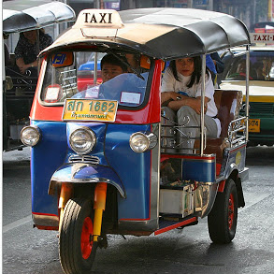
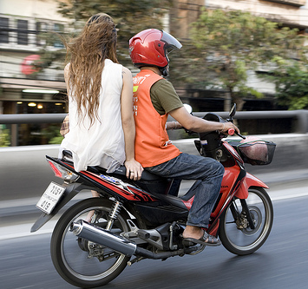
Travel within Bangkok
Meter Taxi – Charge by meter
Tuk Tuk – Charge by bargaining
Motorbike Taxi – Charge by bargaining or fixed price

Slide 10
Phone & Sims Card
You can purchase a new sim card at phone shops and many convenience stores like 7-11
There are 3 main network providers in Thailand:
True Move
DTAC (pre-paid is known as Happy)
AIS (pre-paid is known as 1-2-call)

Slide 11
Accommodation Options
Common Apartment
an en-suited studio, without kitchen
Serviced-Apartment
a fully furnished en-suited studio or a flat with more than 1 bedroom)

Slide 12
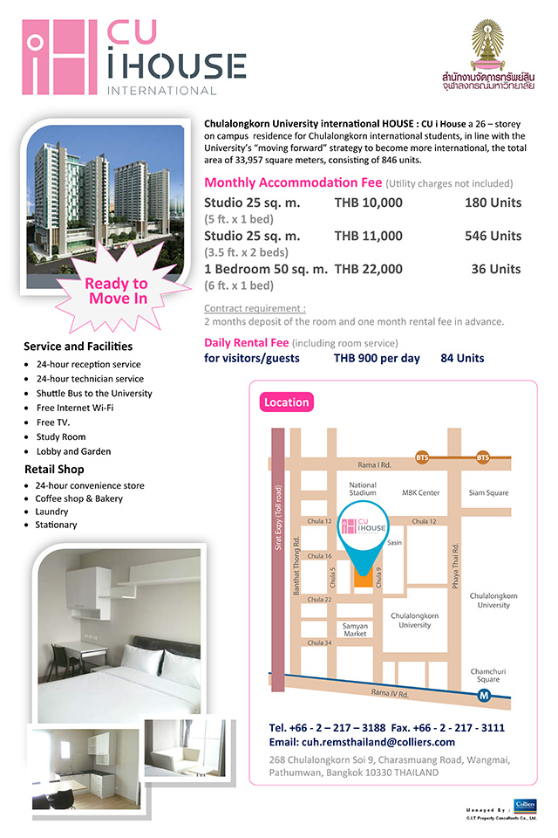
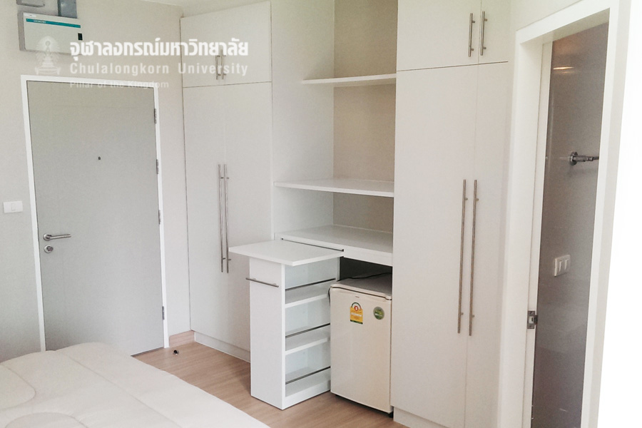
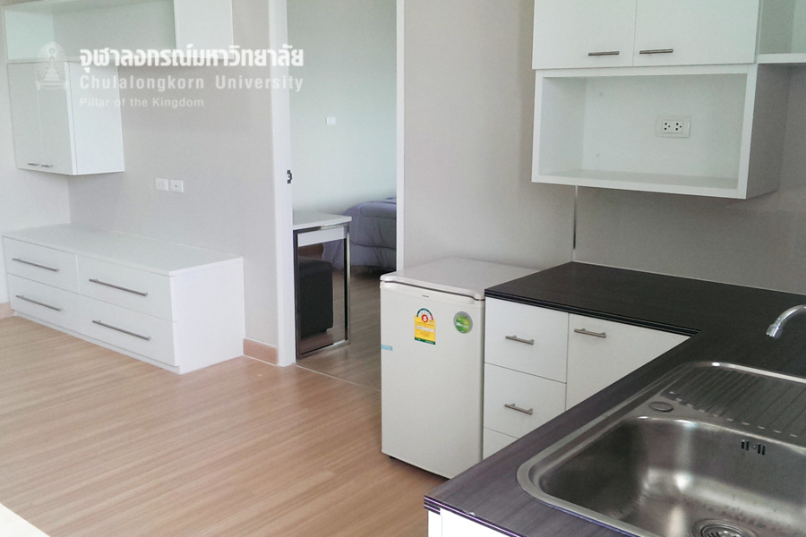
University’s Apartment

Slide 13
